Slide 1

Результаты ЭЭГ и фМРТ:
Надежность и воспроизводимось

Slide 2
Keywords
Consistency/Reliability
Inter-subject Variability
Heterogeneity
Reproducibility/Replicability
Statistical Power
Uncertainty
Interval Estimates
Evidence

Slide 3
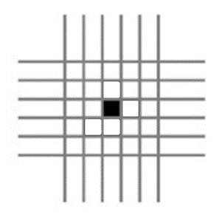
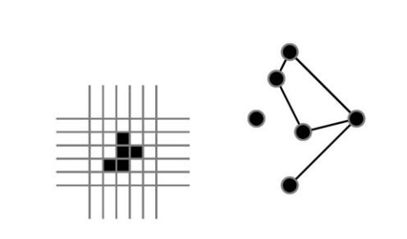
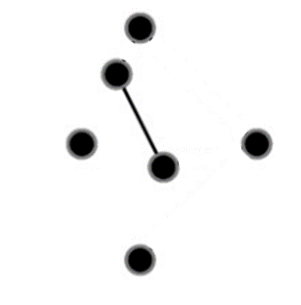
Levels of inference
Voxel-level
Cluster-level
Set-level
Single connection (edge)
Subnetwork (cluster)
Network

Slide 4
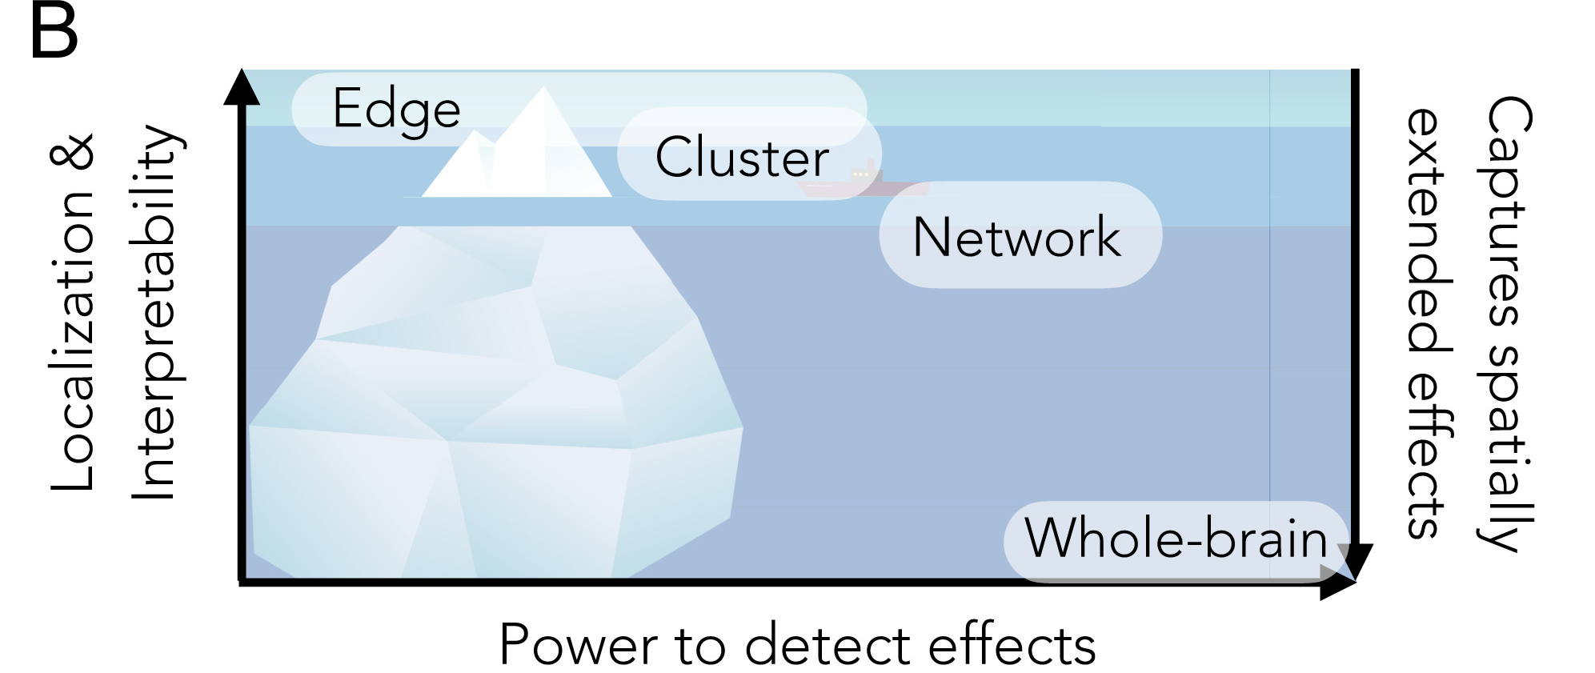
Levels of inference

Slide 5

Levels of inference
https://www.pnas.org/doi/10.1073/pnas.2203020119

Slide 6
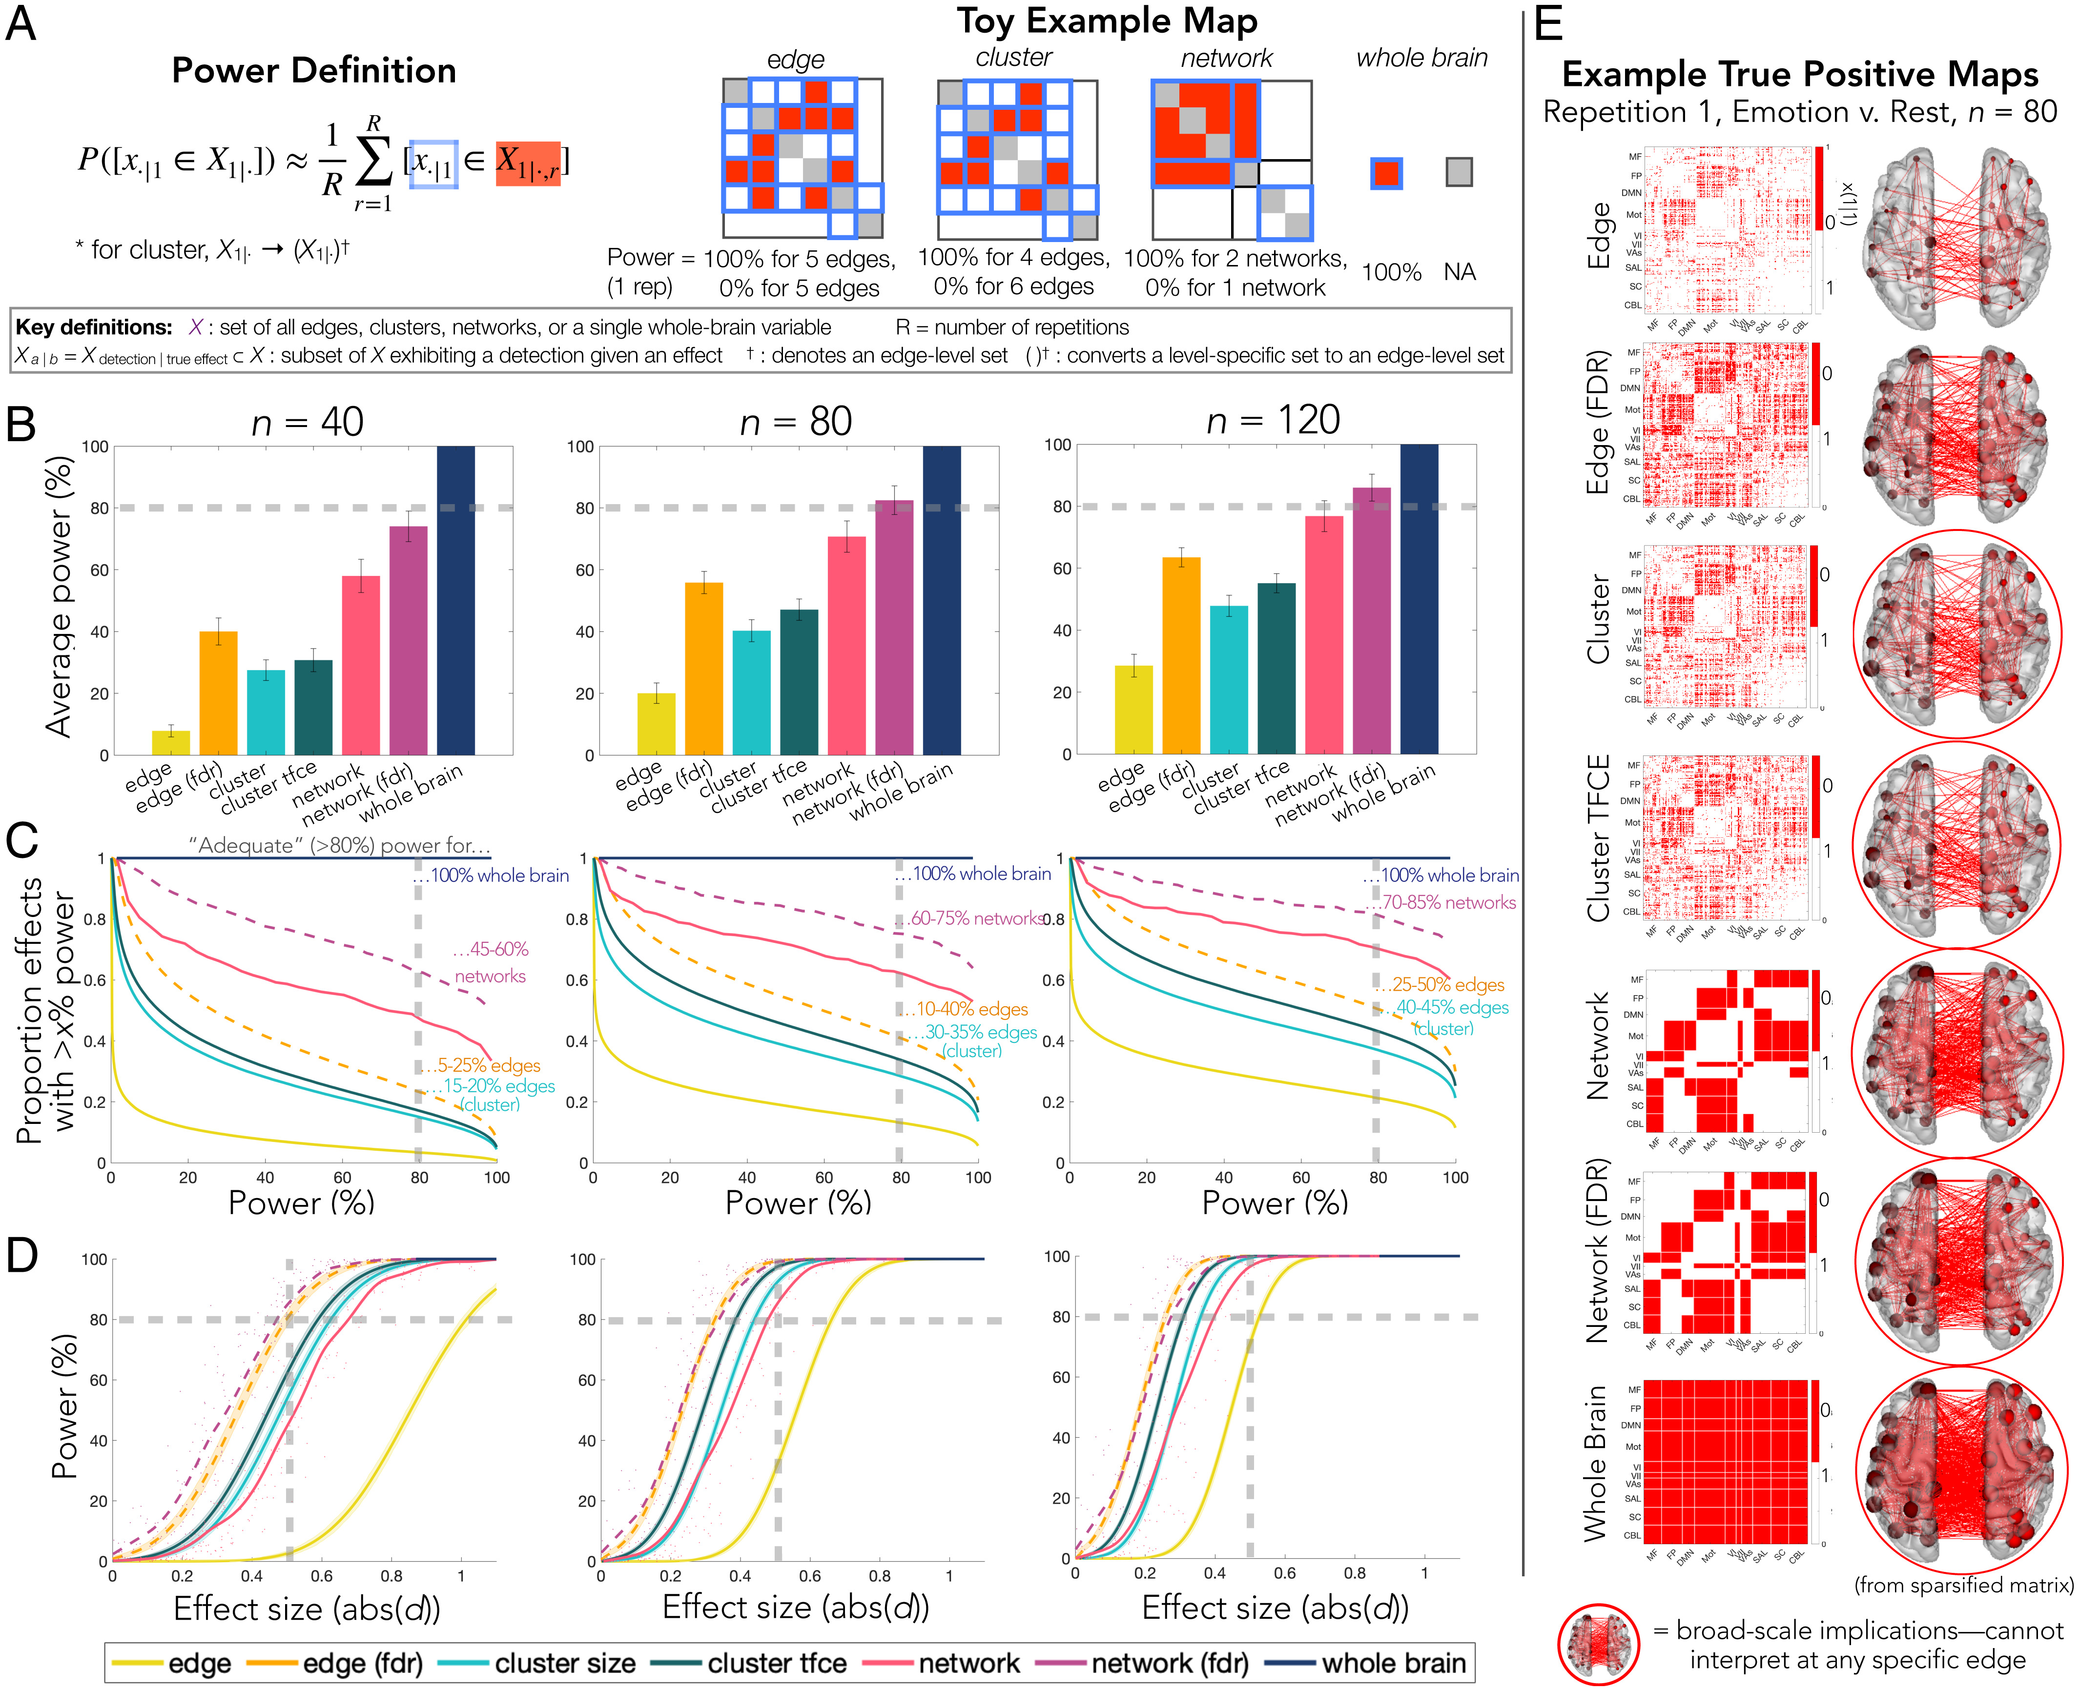
Levels of inference

Slide 7
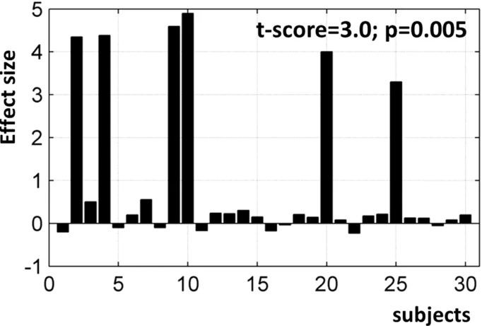
Variability
Effect size
Within-subject
Variability
Inter-subject Variability (Population heterogeneity)
Large
Medium
Small
Large
Medium
Small
Large
Medium
Small
Example:
High effect
Small variability (if we account for heterogeneity)
High heterogeneity

Slide 8
Variability
High effect
Small variability
High heterogeneity
Low effect
High variability
Low heterogeneity
True distribution (non-Gaussian)
True distribution (Gaussian)
Modelled distribution (Gaussian)
Modelled distribution (Gaussian)

Slide 9
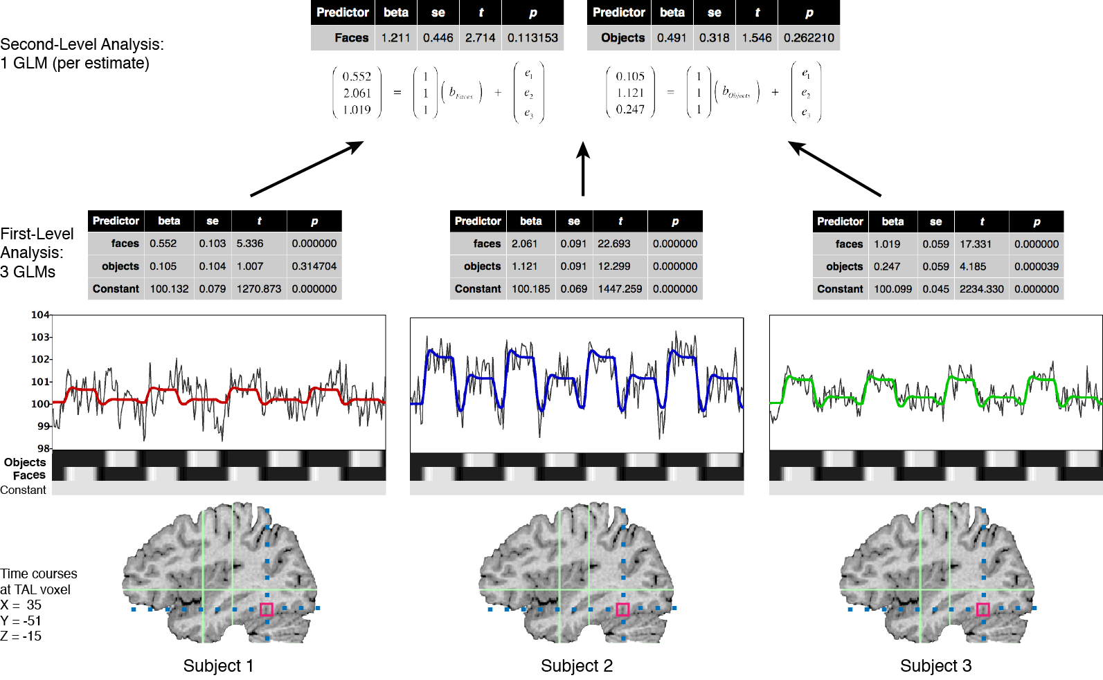
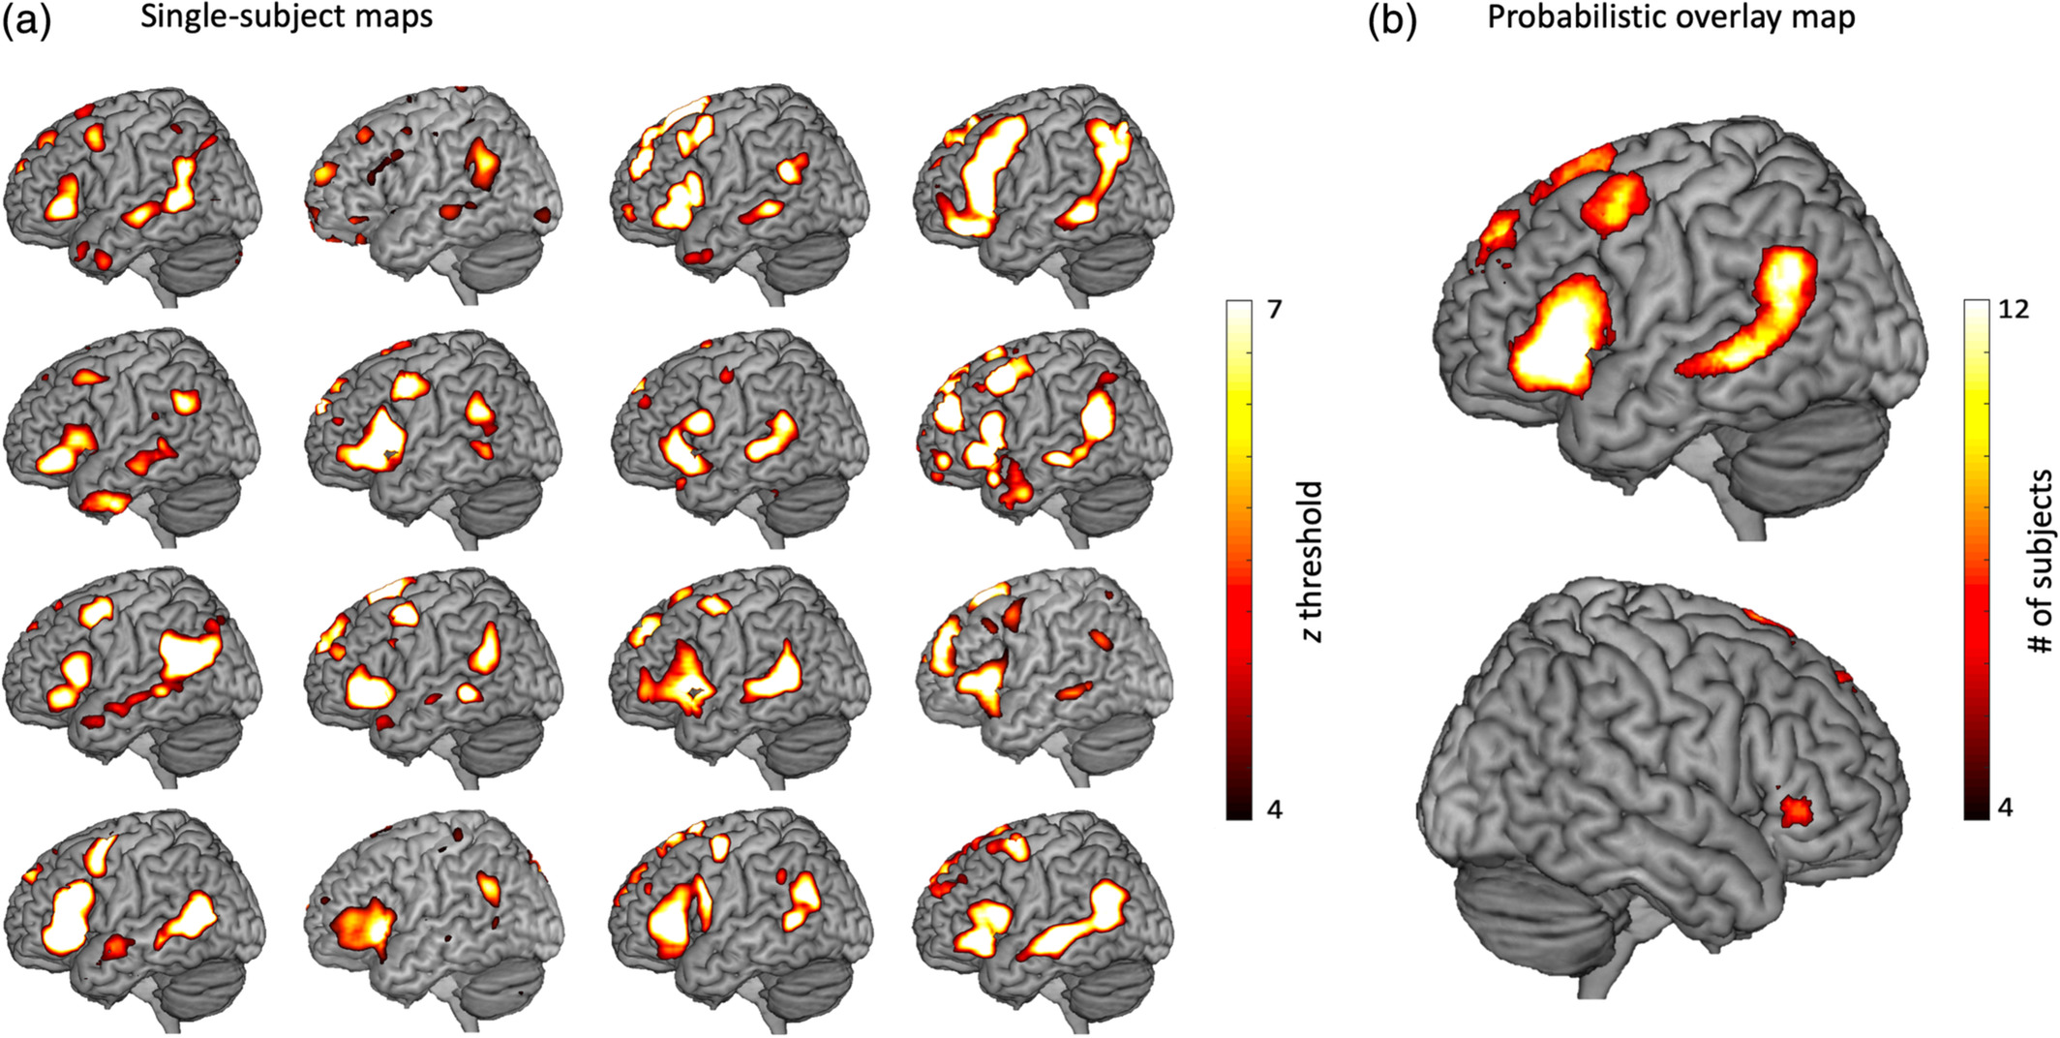
fMRI
Subject 1
First level
Effect size #1 (betas, correlations, ...)
Test statistic #1 (t-vales, z-values, …)
P-value #1
Sub1
Subject 2
fMRI signal
Effect size #2
Test statistic #2
P-value #2
Sub2
Subject 3
Effect size #3
Test statistics #3
P-value #3
Sub3
Time

Slide 10
fMRI
Subject 1
First level
Second level
Effect size #1 (betas, correlations, ...)
Test statistic #1 (t-vales, z-values, …)
P-value
T-test
Subject 2
Group Effect
Group Test statistic
Group P-value
BOLD signal
Effect size #2
Test statistic #2
P-value #2
Subject 3
Effect size #3
Test statistics #3
P-value #3
Time
Group

Slide 11
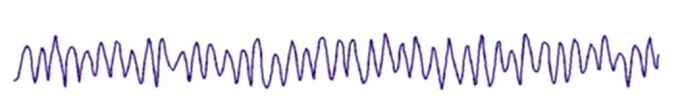
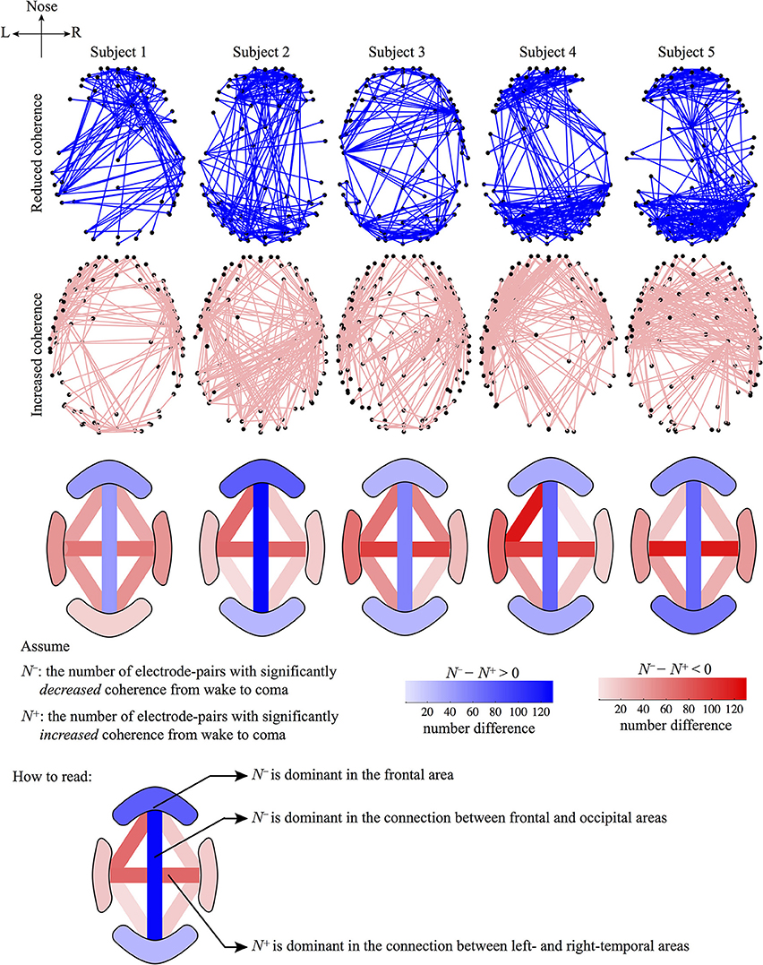
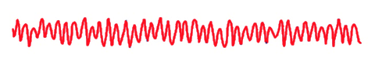
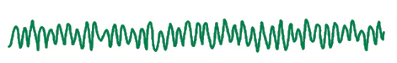
EEG
Subject 1
First level
Effect size #1 (Coherence, power, ...)
Test statistic #1 (t-vales, z-values, …)
P-value #1
. . .
Sub1
Subject 2
EEG signal
Effect size #2
Test statistic #2
P-value #2
. . .
Sub2
Subject 3
Effect size #3
Test statistics #3
P-value #3
. . .
Sub3
Time

Slide 12
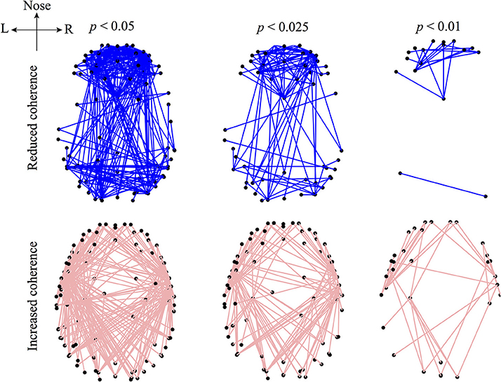
EEG
Subject 1
First level
Second level
Effect size #1 (Coherence, power, ...)
Test statistic #1 (t-vales, z-values, …)
P-value #1
. . .
T-test
Subject 2
Group Effect
Group Test statistic
Group P-value
EEG signal
Effect size #2
Test statistic #2
P-value #2
. . .
Subject 3
Effect size #3
Test statistics #3
P-value #3
. . .
Time
Group

Slide 13
fMRI
Subject 1
First level
Effect size #1 (betas, correlations, ...)
Test statistic #1 (t-vales, z-values, …)
P-value #1
Sub1
Subject 2
fMRI signal
Effect size #2
Test statistic #2
P-value #2
Sub2
Subject 3
Effect size #3
Test statistics #3
P-value #3
Sub3
Time

Slide 14
fMRI: Probabilistic overlay map
https://doi.org/10.1002/hbm.24821

Slide 15
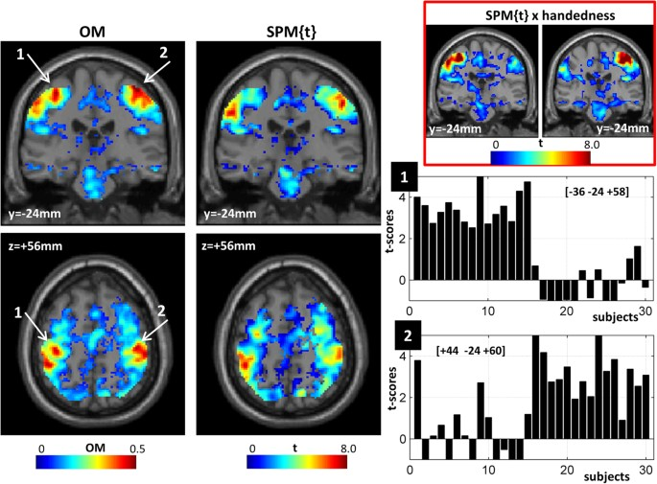
fMRI: Overlap maps
Overlap Map
pFWE<0.05
doi: 10.1038/srep20170

Slide 16
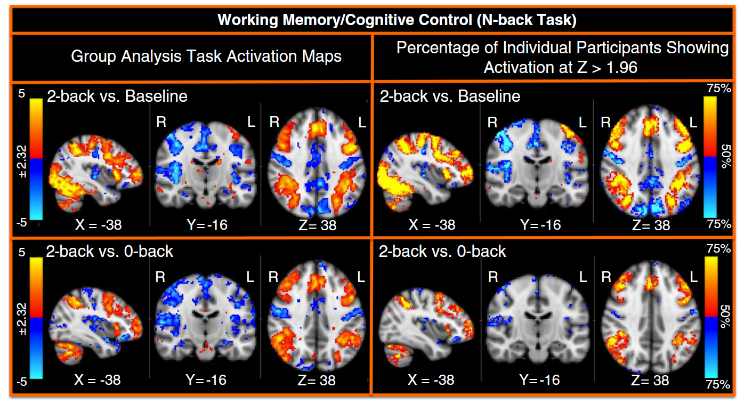
fMRI: Activation count maps
http://dx.doi.org/10.1016/j.neuroimage.2013.05.033

Slide 17
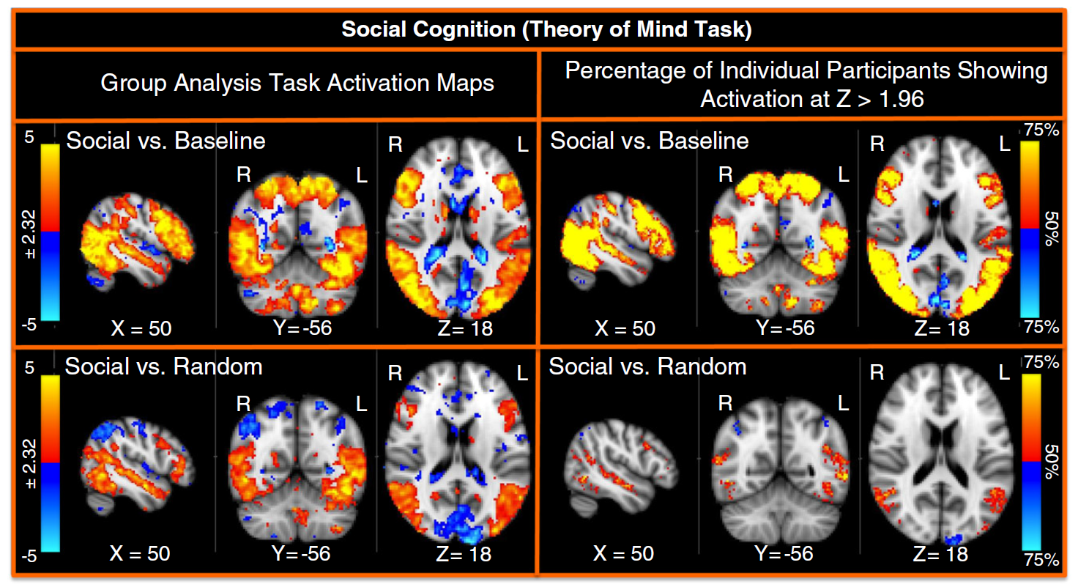
fMRI: Activation count maps
http://dx.doi.org/10.1016/j.neuroimage.2013.05.033

Slide 18
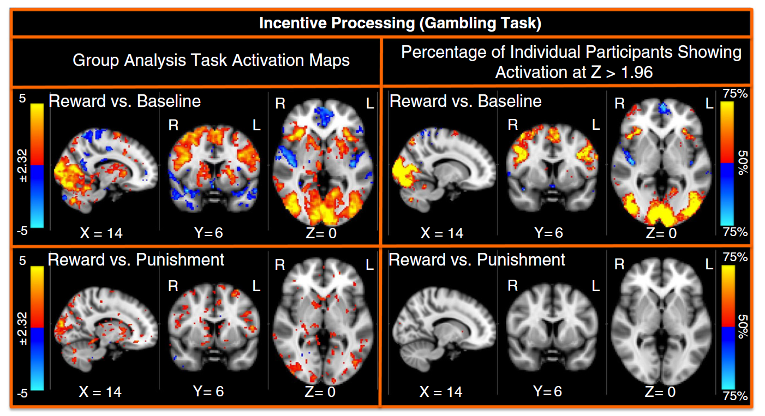
fMRI: Activation count maps
http://dx.doi.org/10.1016/j.neuroimage.2013.05.033

Slide 19
EEG: Probabilistic overlay map
1. Individual subject inference
2. Group level inference
3. Probabilistic overlay map ?
https://doi.org/10.3389/fnsys.2014.00215

Slide 20
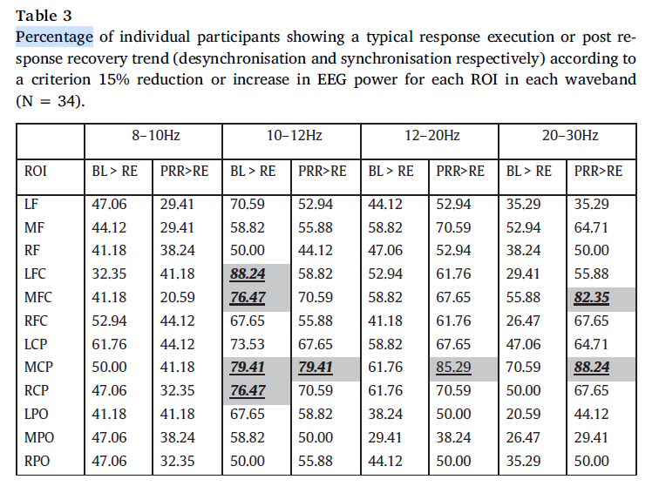
EEG: Inter-subject variation
http://dx.doi.org/10.1016/j.ijpsycho.2017.07.009

Slide 21
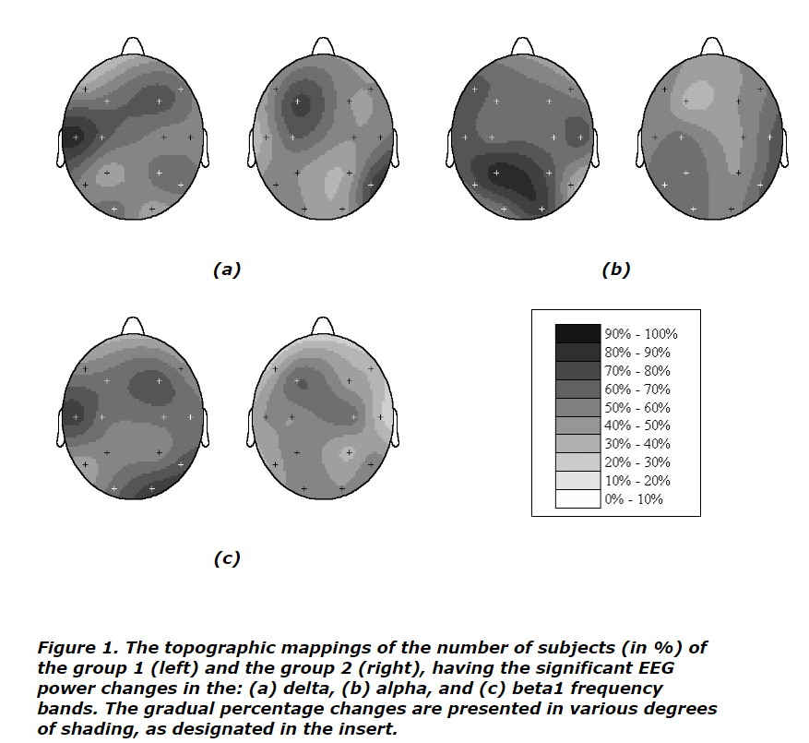
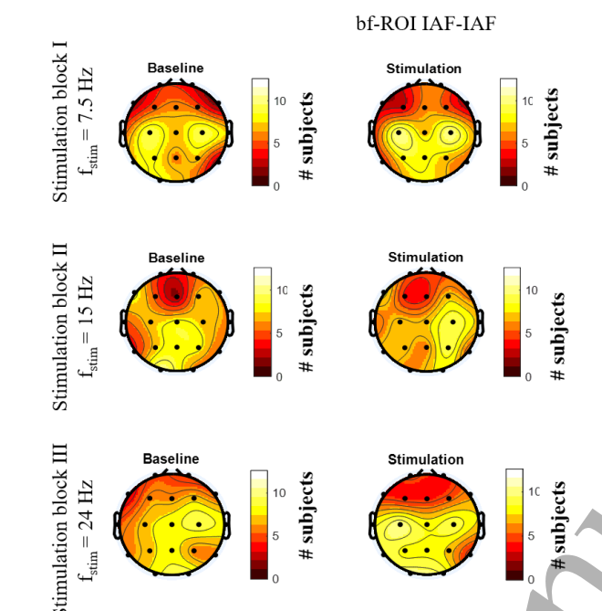
EEG: Inter-subject variation
percentage of subjects
https://vxm.com/link.CONSC.acup.html
https://iopscience.iop.org/article/10.1088/1741-2552/ab296e

Slide 22
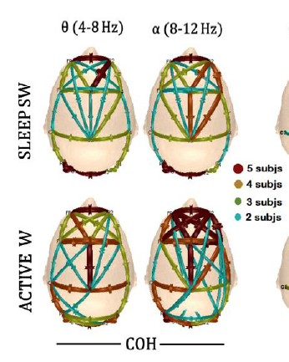
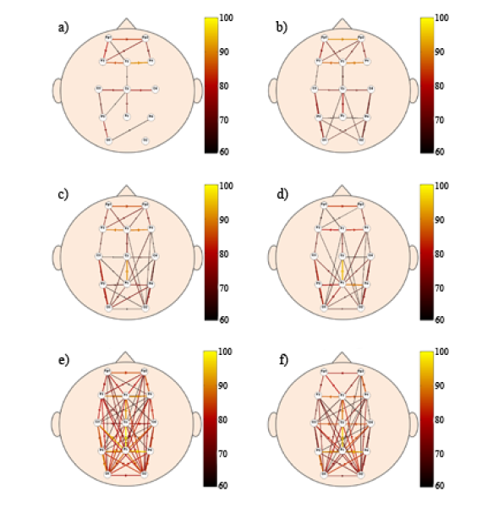
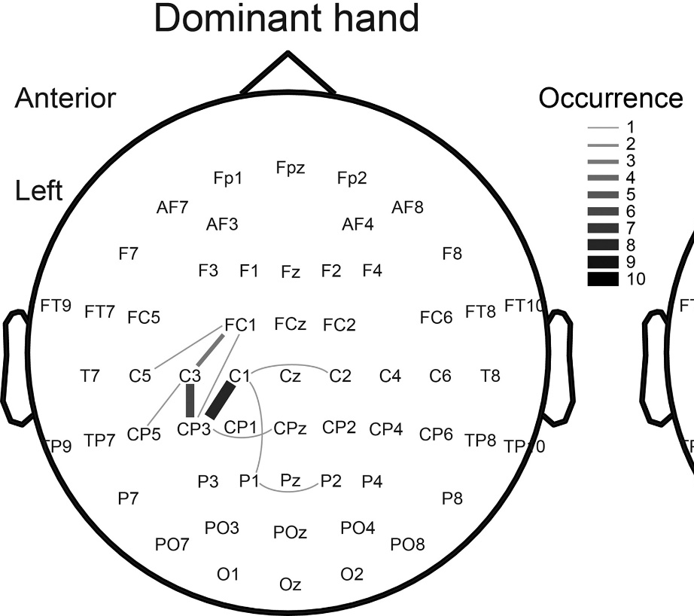
EEG: Inter-subject variation
percentage of subjects
10.1007/978-3-319-32703-7_1
10.1109/EMBC.2012.6346483
10.1152/jn.00562.2020

Slide 23
EEG: Reproducibility
Если у нас нет статистики с первого уровня анализа
«Хороший относительно большой размер выборки»
Порог
p<0.05
Воспроизводимость, %
N = 100
N = 176
100 раз
100 раз
N = 30
Порог
p<0.05
Воспроизводимость, %
«Широко распространённый относительно небольшой размер выборки»

Slide 24
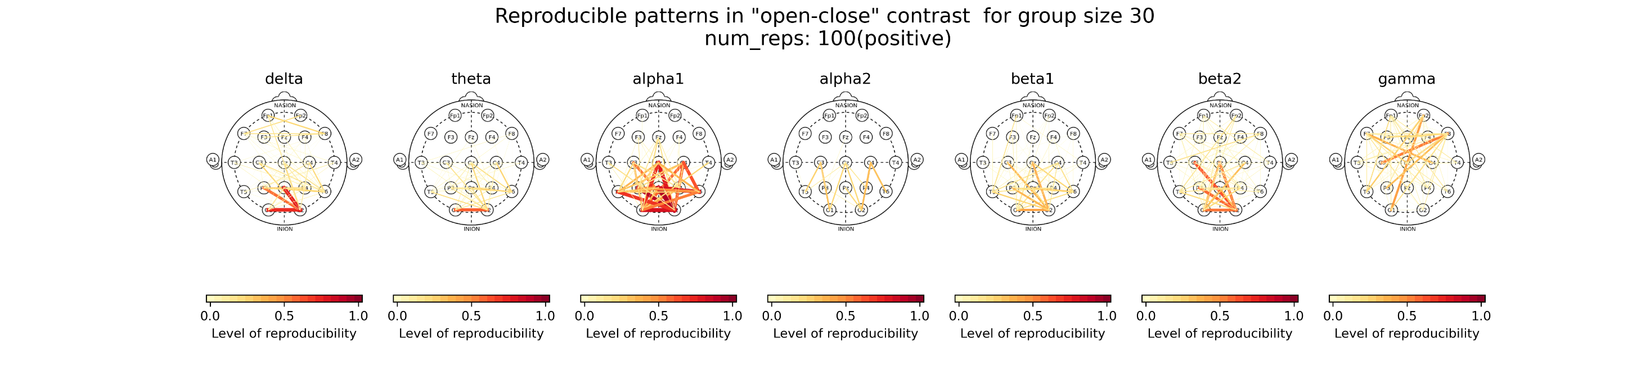
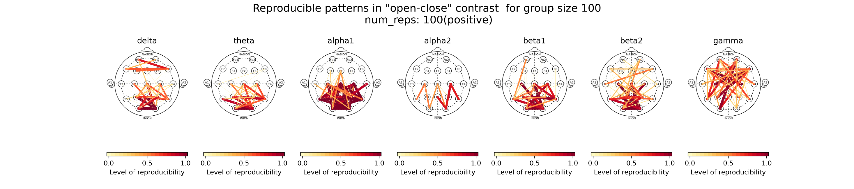
EEG: Reproducibility
Open>Close :: N = 30
Open>Close :: N = 100

Slide 25
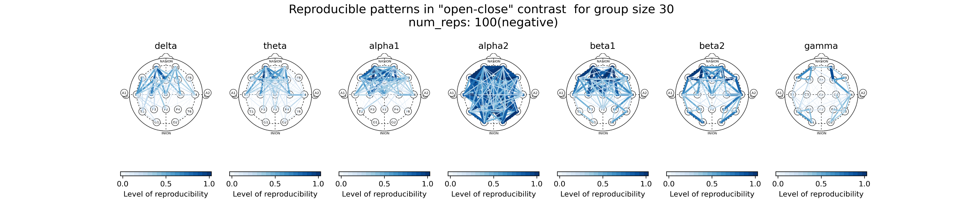
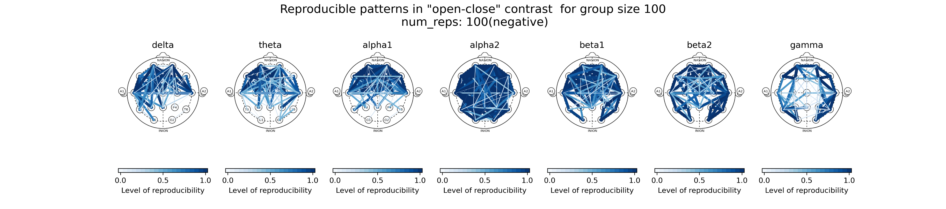
EEG: Reproducibility
Close>Open :: N = 30
Close>Open :: N = 100

Slide 26
EEG: Reproducibility
N = 30
N = 100
Open>Close
Close>Open

Slide 27
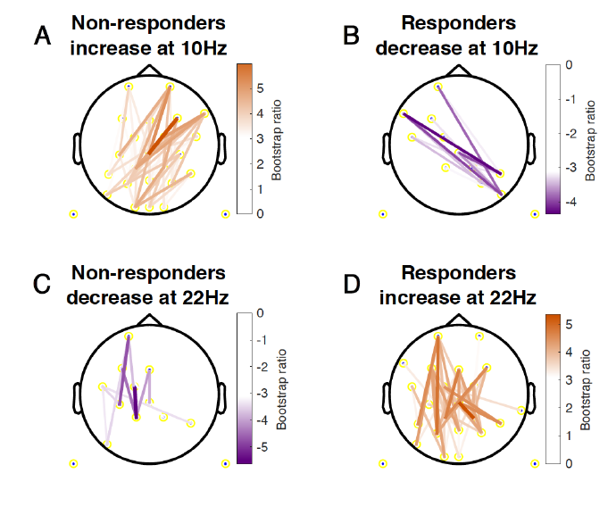
EEG: Consistency/Reliability
Responders vs Non-responders
Phase lag index
This consistency is quantified as a bootstrap ratio, which is calculated by dividing the element
loadings by the standard error of the created bootstrap distribution for each element. In addition to
determining the stability of the pattern, bootstrap resampling also protects against the influence of
outliers, as subsamples with and without the outlier would produce different outcomes, thereby
decreasing the consistency of the findings (i.e. the bootstrap ratio). In practice, this means that effects that
are driven largely by an outlier get attenuated. Bootstrap ratios are similar to z-scores, with absolute
values ≥ 3.1 corresponding to ~99% confidence interval.
“the most consistent change in connectivity”
http://dx.doi.org/10.1016/j.ijpsycho.2017.07.009

Slide 28
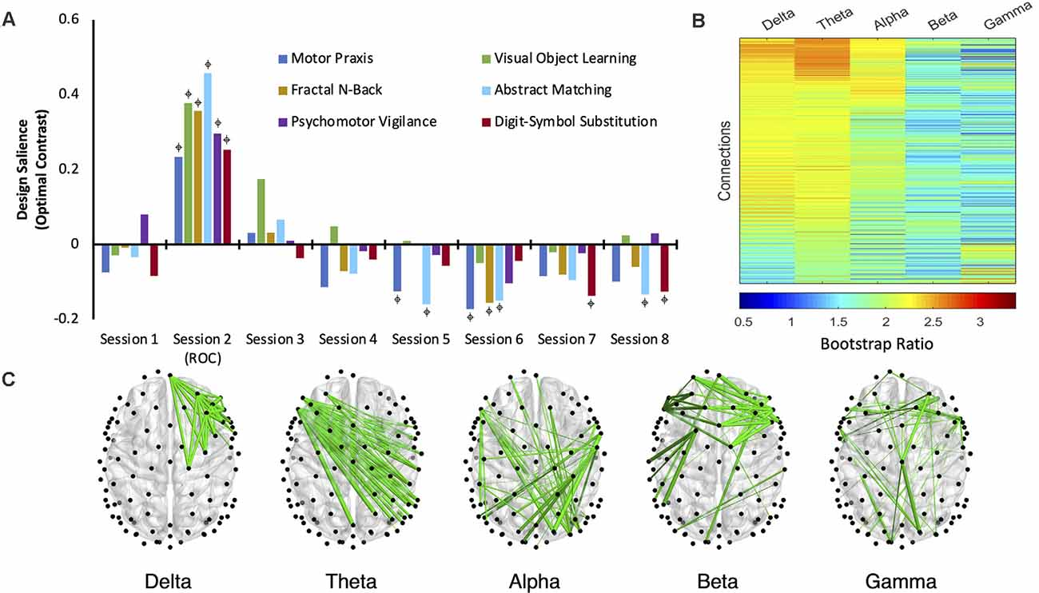
EEG: Consistency/Reliability
Bootstrap ratios (BSRs) for each connection (pair of electrodes) associated with each frequency band. The higher the BSR magnitude, the more reliably the connection expressed the contrast in its present orientation (see “Materials and Methods” section). (C) The top 1% of connections that reliably express the contrast, determined by thresholding the BSRs.
https://doi.org/10.3389/fnhum.2021.706693

Slide 29
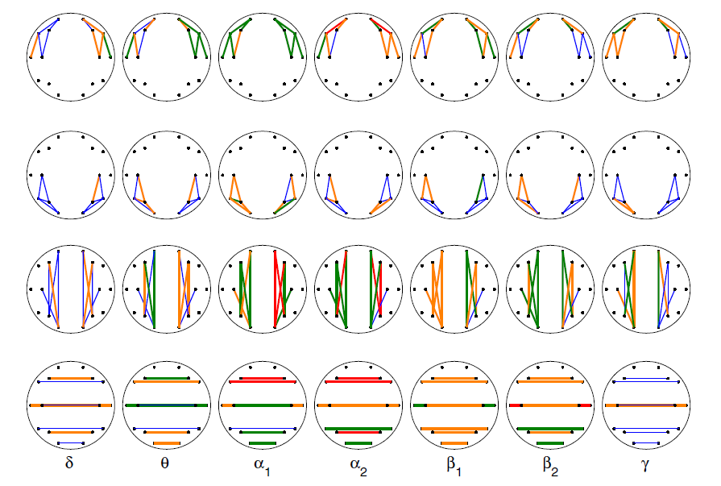
EEG: Reliability
N = 15, 10 recordings over 2 months
Eyes closed
Reliability - Intraclass correlation coefficient (ICC)
>0.07
0.55-0.7
0.4-0.55
<0.55
Reliability was highest for the α bands, followed by θ and β bands, δ and γ bands had lowest reliability. The local posterior area was slightly less reliable than the
other areas.
doi:10.1016/j.clinph.2007.06.018

Slide 30
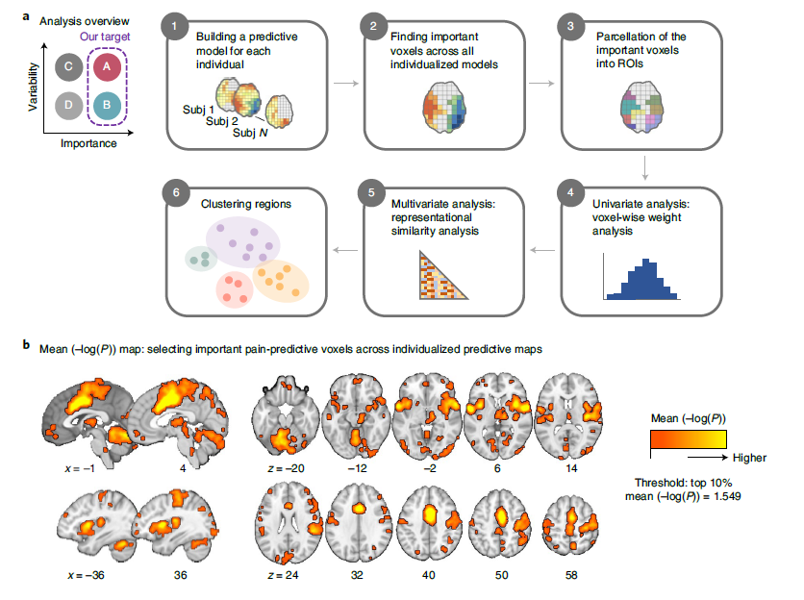
fMRI: Individual variability
Single subject:
Support vector regression (SVR)
Prediction-outcome correlation
Bootstrap P-values
Group:
“Importance”: Mean(-log(p))
Unlike the group-level predictive modeling approach, which can identify only brain regions with multivariate pattern information consistent across individuals, our approach allows us to identify brain regions important for pain prediction within each individual, even if the brain regions have distinct patterns across individuals.
Nature neuroscience 2022
https://doi.org/10.1038/s41593-022-01081-x

Slide 31
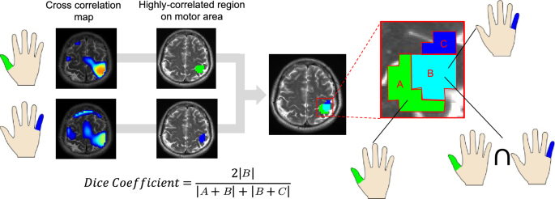
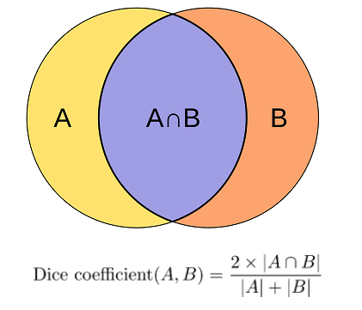
fMRI: Dice coefficient

Slide 32
EEG: Dice coefficient
Sample 1
Sample 2
N = 50
Dice = 0,6
Dice = 0,9
N = 100

Slide 33
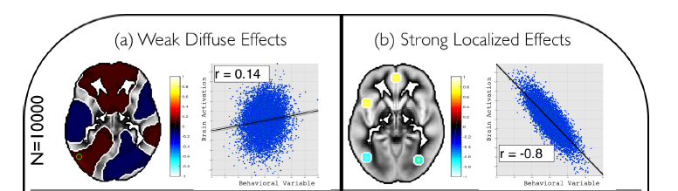
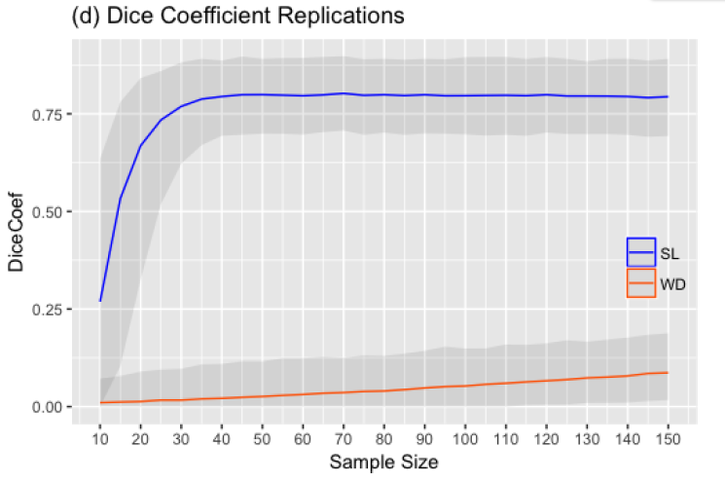
fMRI: Dice Coefficient and Sample Size
STRONG
LOCALIZED
WEAK
DIFFUSE
10.1371/journal.pone.0184923

Slide 34
EEG: Dice Coefficient and Sample Size
Global reliability
Alpha
Beta
Dice Coeff
Gamma
20
50
70
100
170
Sample size

Slide 35
Variability
High effect
Small variability
High heterogeneity
Low effect
High variability
Low heterogeneity
True distribution
True distribution
Sampling distribution
Sampling distribution

Slide 36
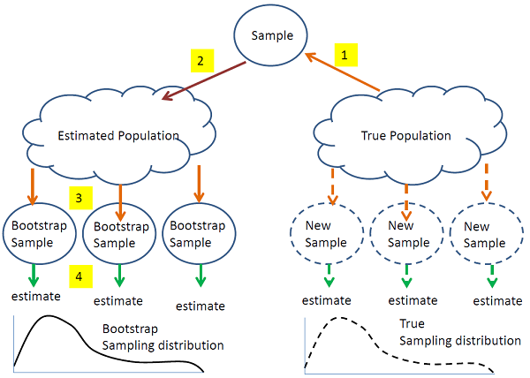
Bootstrapping

Slide 37
Bootstrapping
The bootstrap is used for estimating standard errors and bias, obtaining confidence intervals,
and sometimes for tests.
The common combination of nonparametric bootstrapping and bootstrap percentile confidence intervals is less accurate than using t-intervals for small
samples, though more accurate for larger samples
The bootstrap just uses a different approach to estimating the standard error.
The bootstrap distribution is centered at the observed statistic, not the population parameter. First, it means that we do not use the mean of the bootstrap
statistics as a replacement for the original estimate.
Instead we use the bootstrap to tell how accurate the original estimate is.

Slide 38
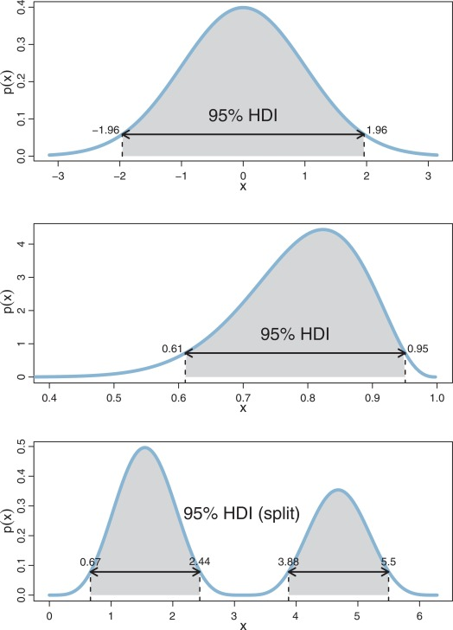
Posterior probability distribution

Slide 39
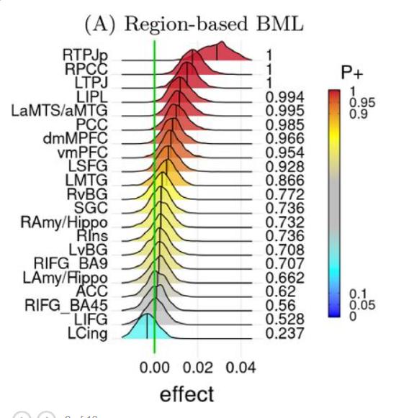
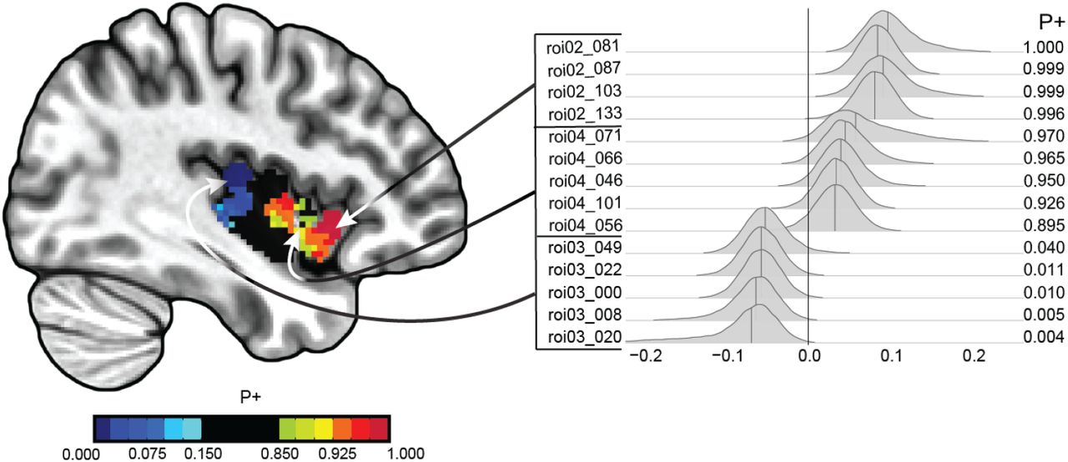
Posterior probability distribution
https://apertureneuropub.cloud68.co/articles/46/

